Slide 1
Let’s see a little bit of the U.S.A. I
Use the mouse

Slide 2
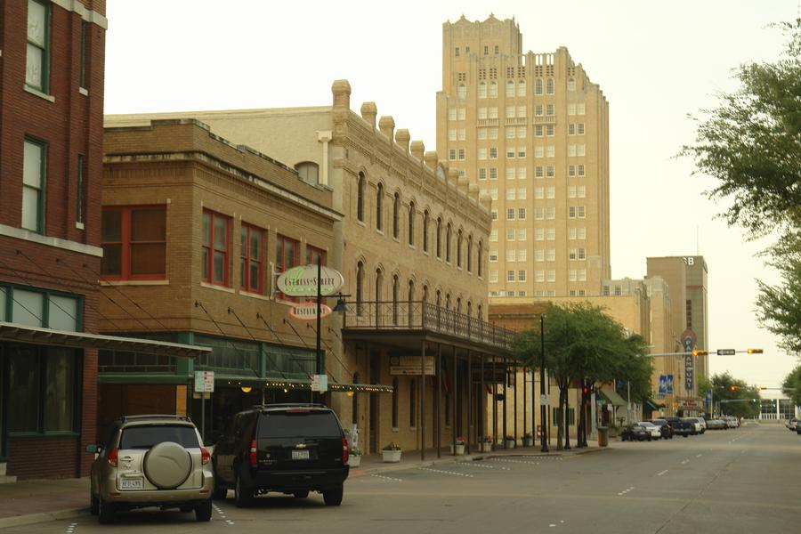
Abilene, Texas

Slide 3
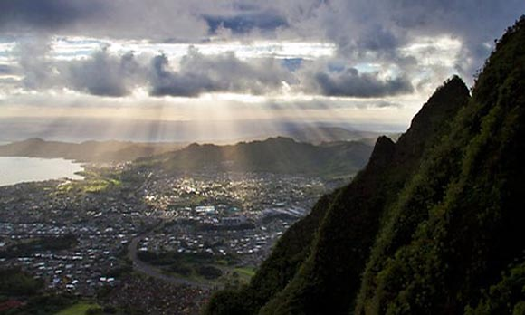
Ala Moana-Kakaato, Honolulu

Slide 4
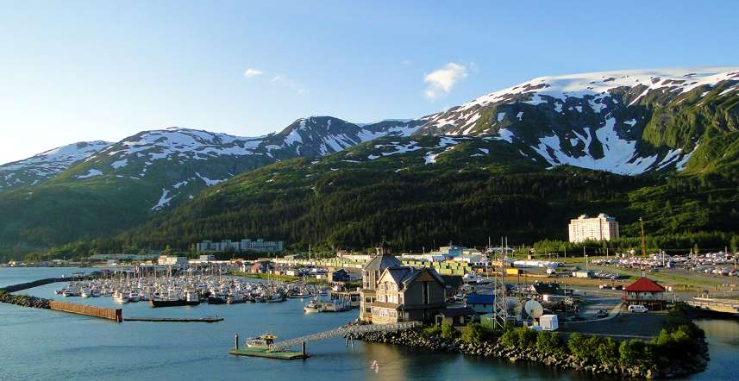
Alaska

Slide 5
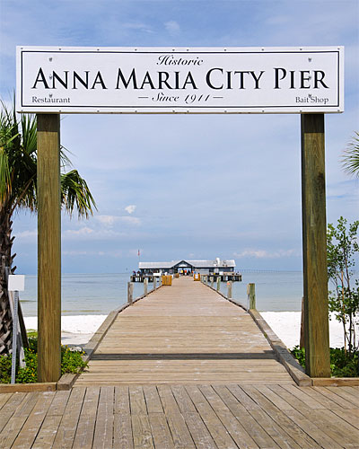
Anna Maria, Florida

Slide 6
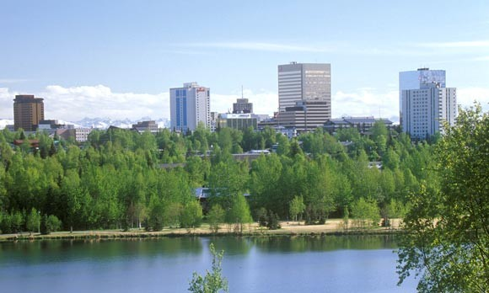
Anchorage, Alaska

Slide 7
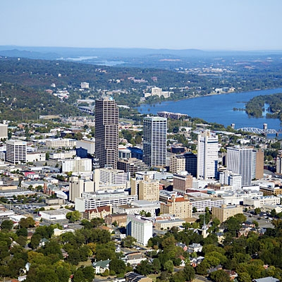
Little Rock, Arkansas

Slide 8
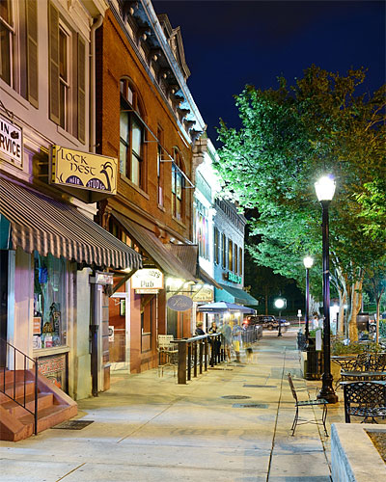
Athens, Georgia

Slide 9
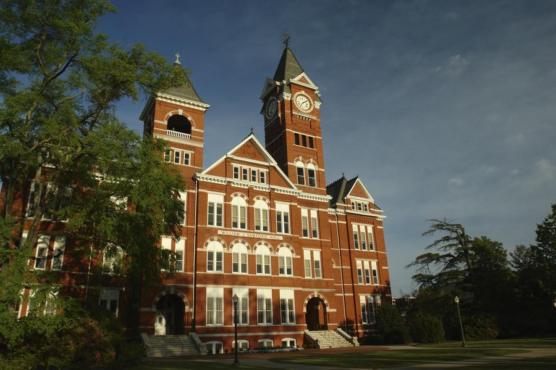
Auburn, Alabama

Slide 10
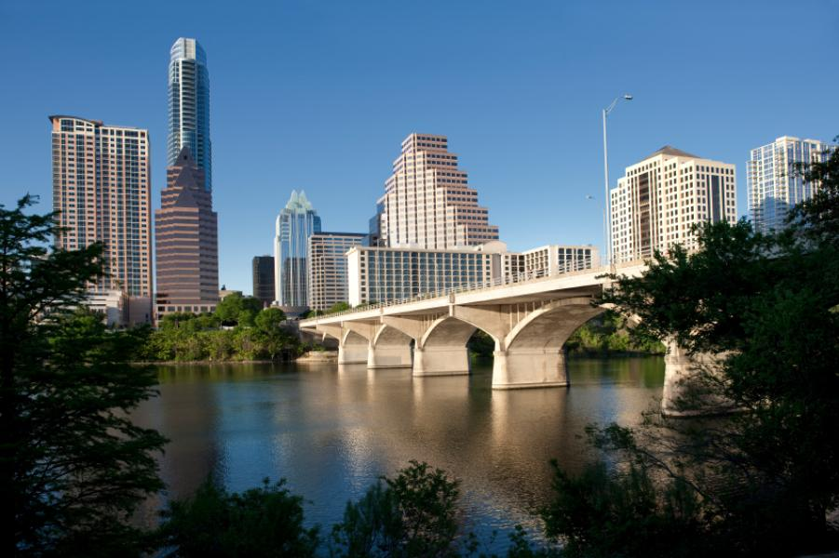
Austin, Texas

Slide 11
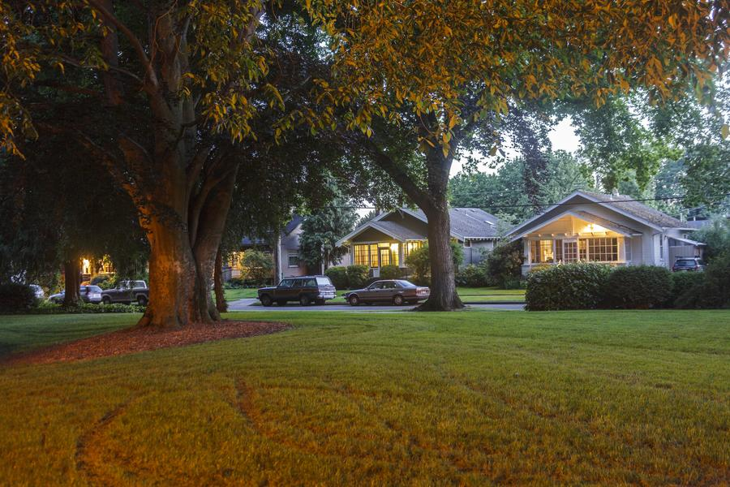
Bellingham, Washington

Slide 12
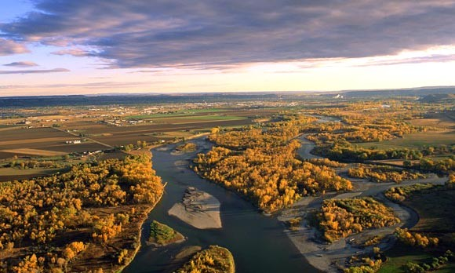
Billings, Montana

Slide 13
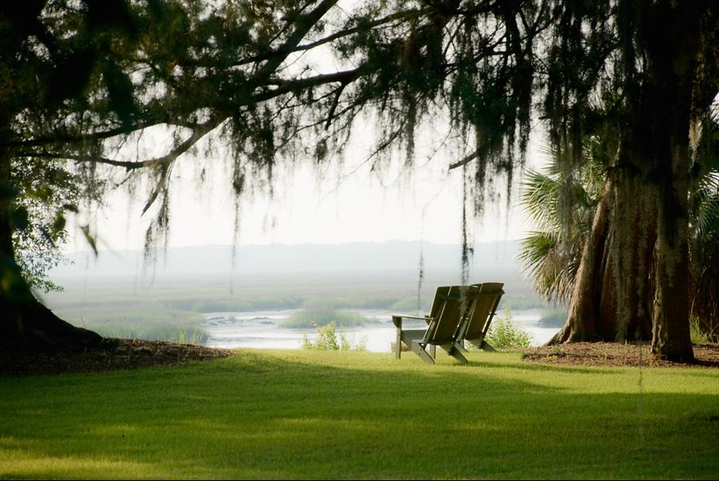
Bluffton, South Carolina

Slide 14
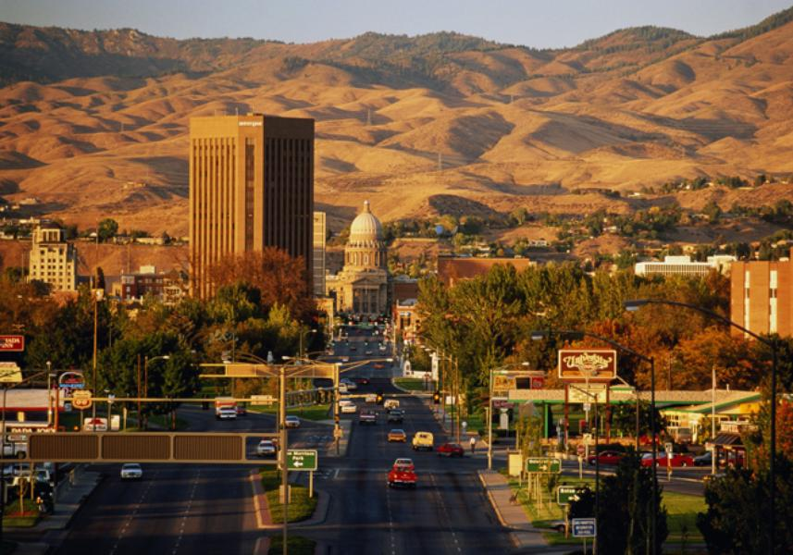
Boise, Idaho

Slide 15
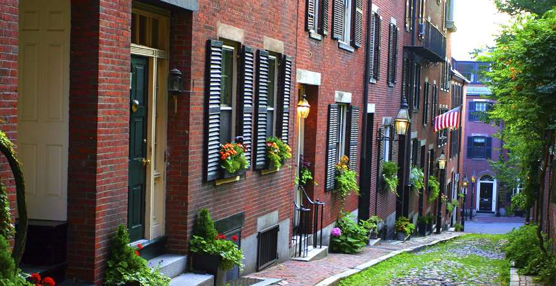
Boston, Massachussets

Slide 16
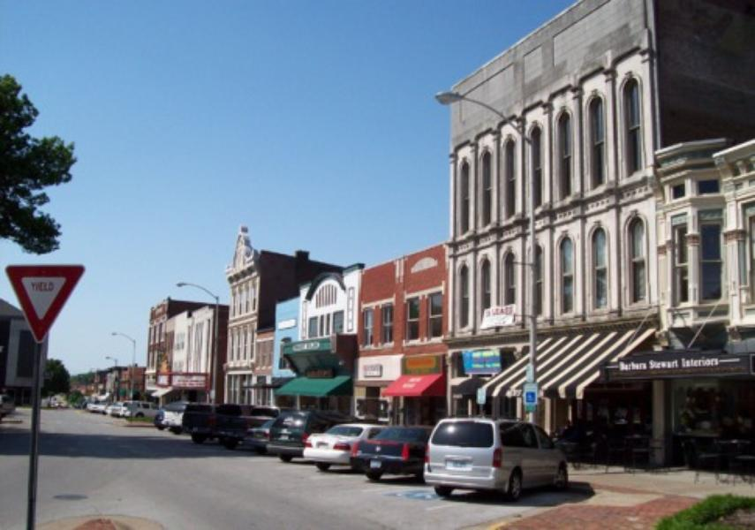
Bowling Green, Kentucky

Slide 17
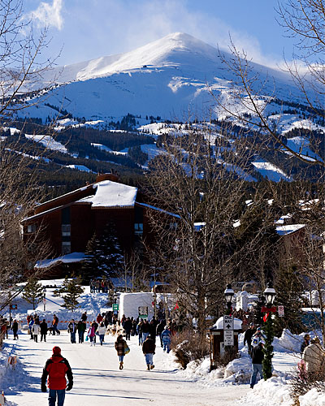
Breckenridge, Colorado

Slide 18
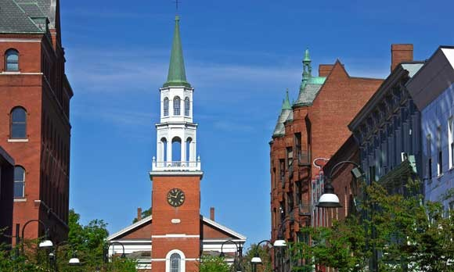
Burlington, Vermont

Slide 19
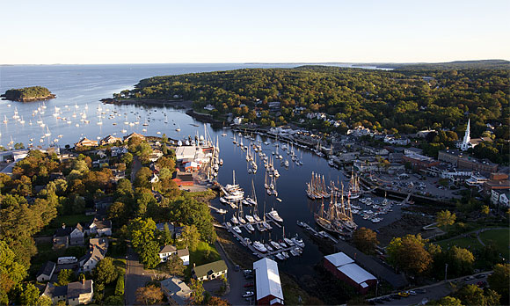
Camden, Maine

Slide 20
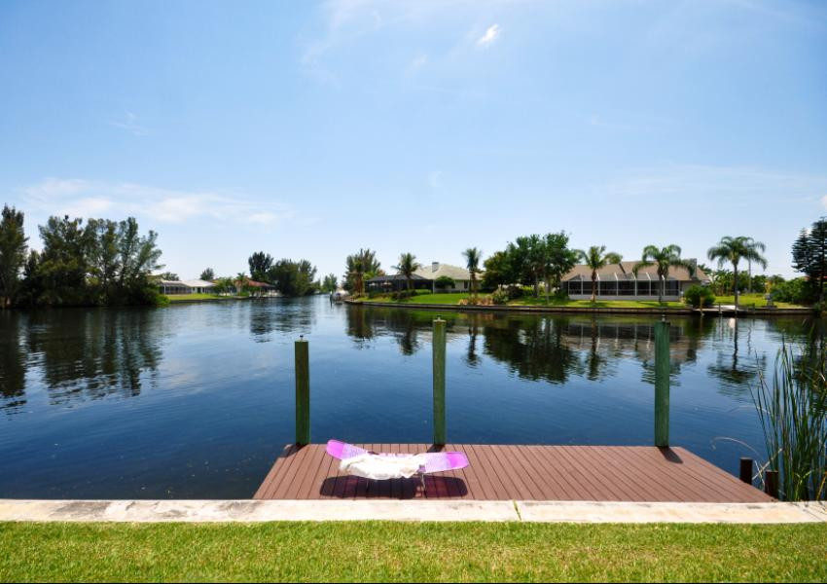
Cape Coral, Florida

Slide 21
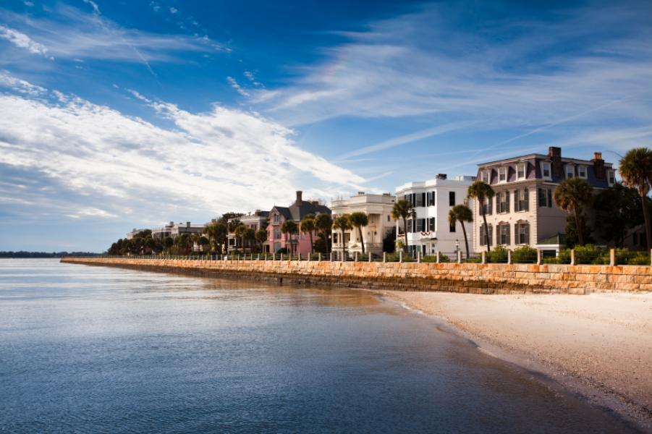
Charleston, South Carolina

Slide 22
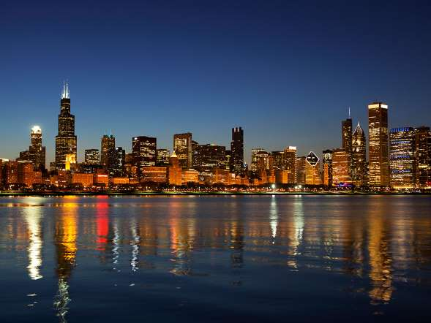
Chicago, Illinois

Slide 23
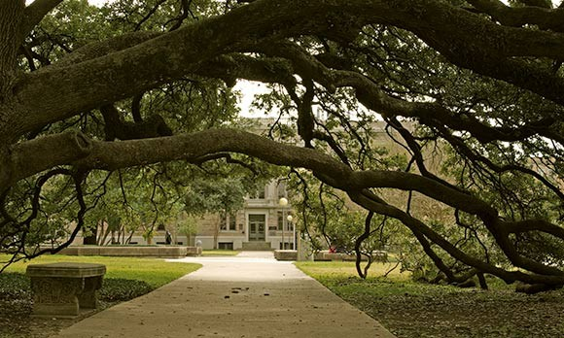
College Station, Bryan, TX

Slide 24
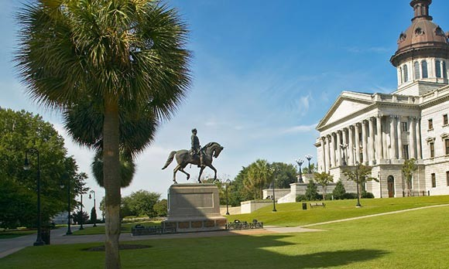
Columbia, South Carolina

Slide 25
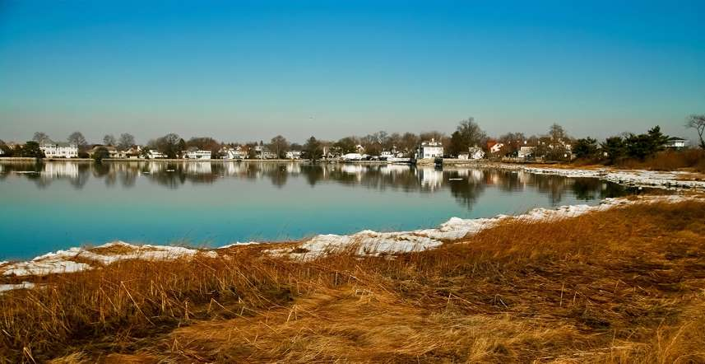
Connecticut

Slide 26
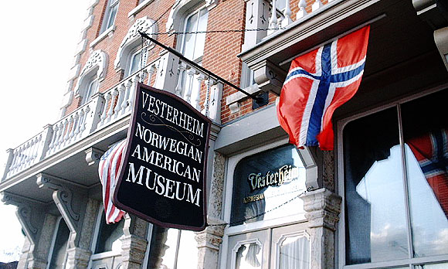
Decora, Iowa

Slide 27
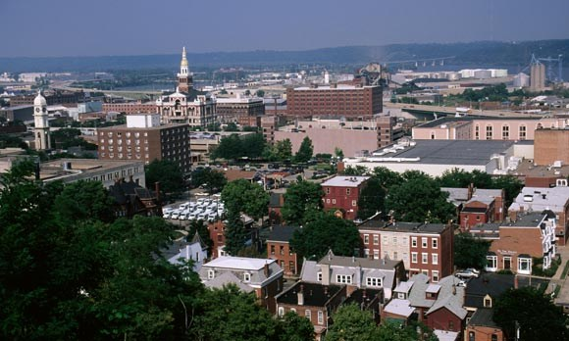
Dubuque, Iowa

Slide 28
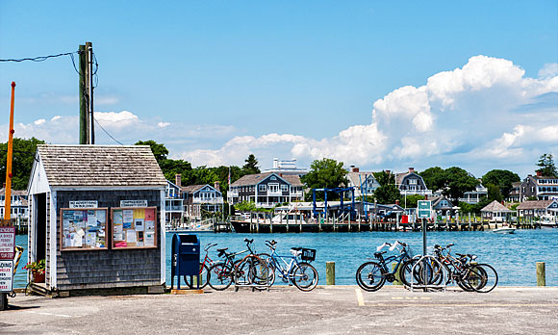
Edgartown, Mass

Slide 29
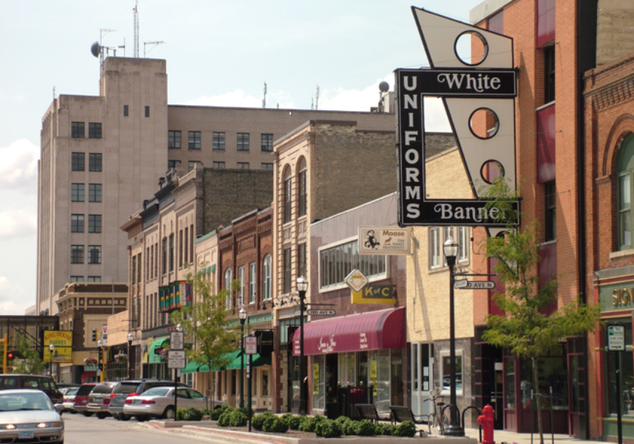
Fargo, North Dakota

Slide 30
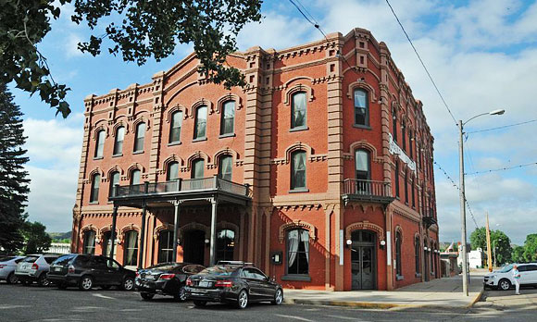
Fort Benton, Montana

Slide 31
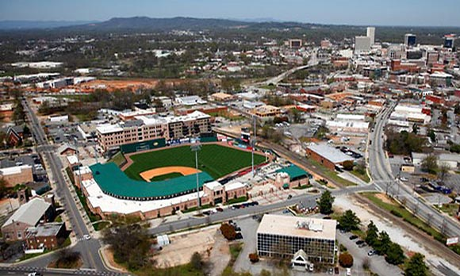
Greenville, South Carolina

Slide 32
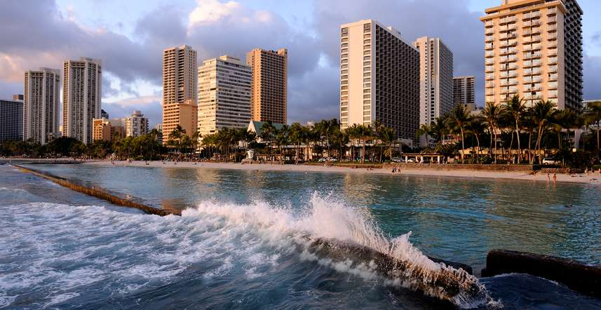
Honolulu, Hawaii

Slide 33
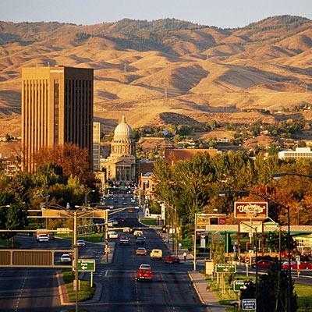
Boise,Idaho

Slide 34
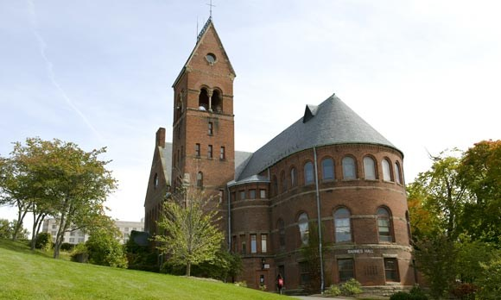
Ithaka, NY

Slide 35
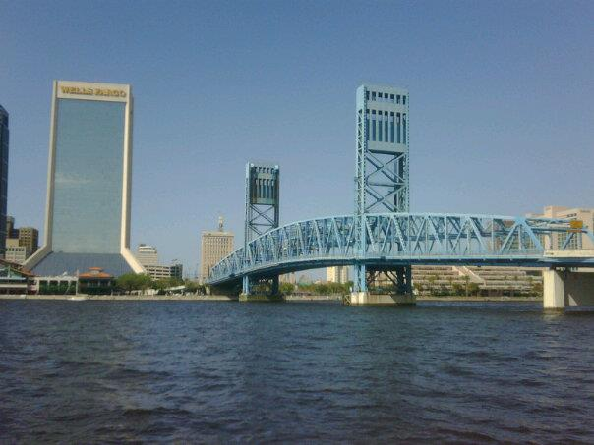
Jacksonville, FL

Slide 36
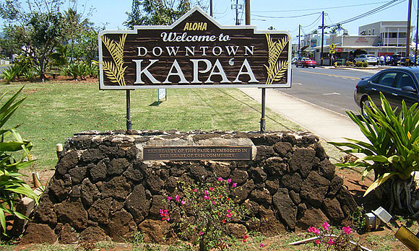
Kapa’a, Hawaii

Slide 37
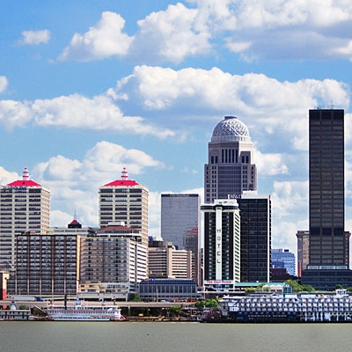
Louisville,Kentuky

Slide 38
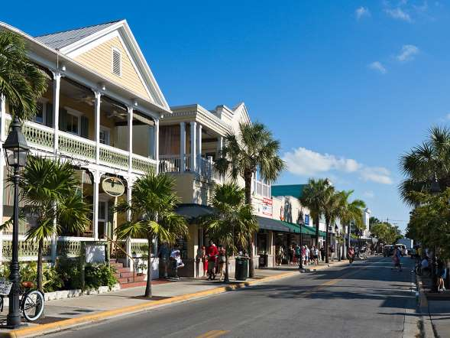
Key West, Florida

Slide 39
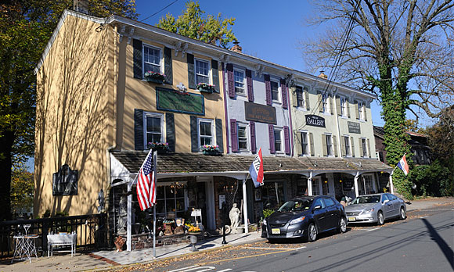
Libertyville, New Jersey

Slide 40
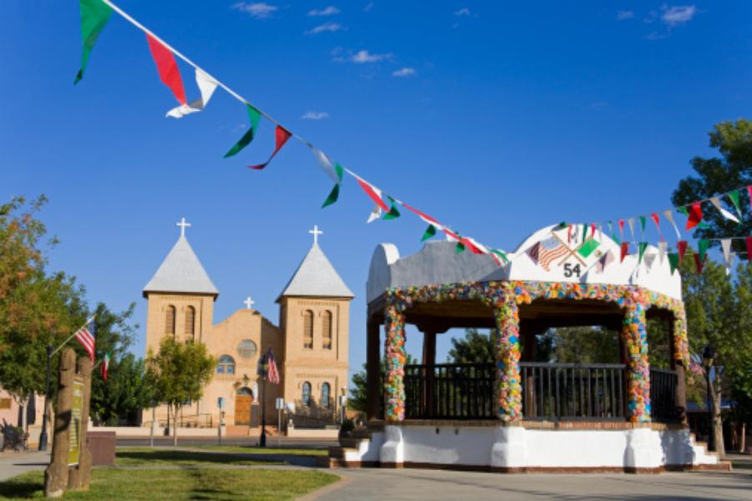
Las Cruces, New Mexico

Slide 41
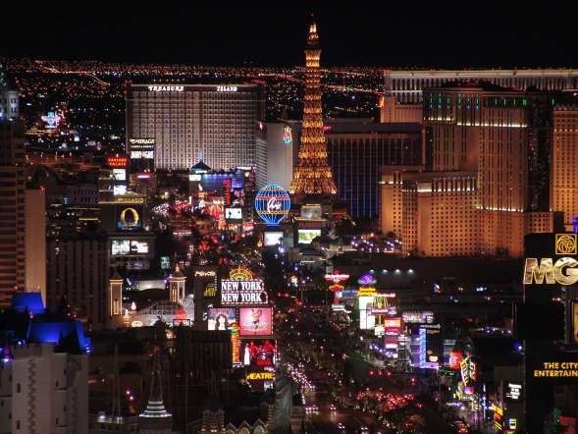
Las Vegas, Nevada

Slide 42
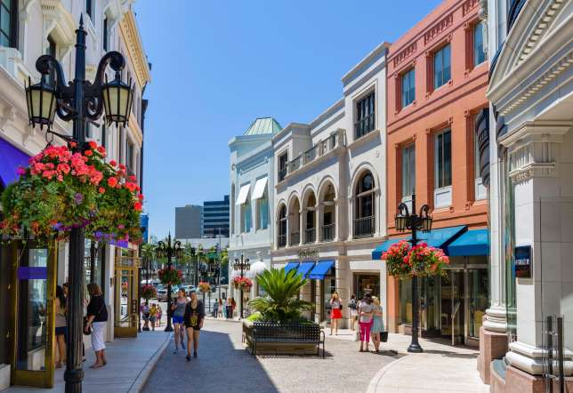
Los Angeles, CA

Slide 43
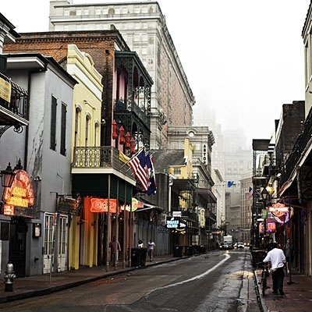
New Orleans, Louisiana

Slide 44
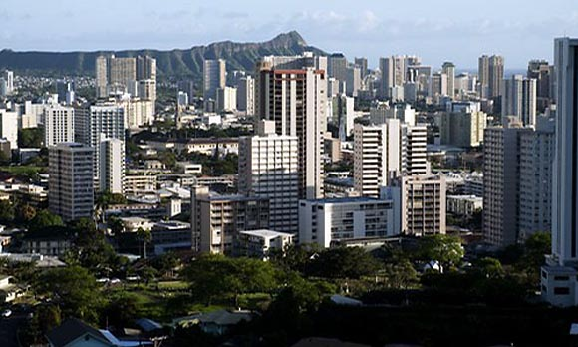
Makiki, Hawaii

Slide 45
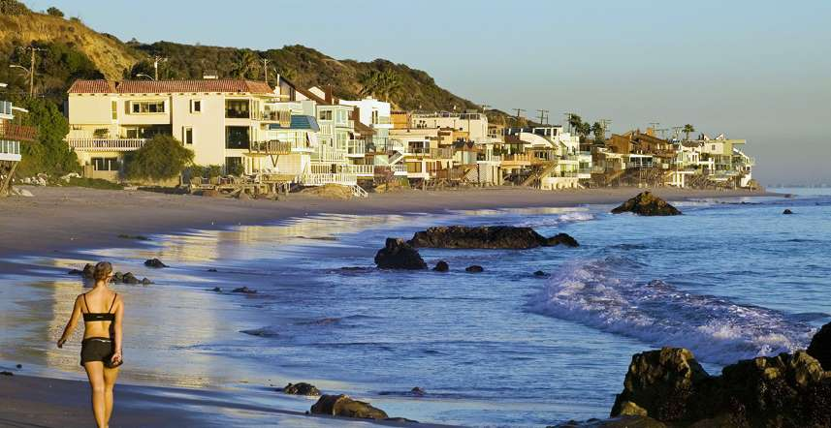
Malibu, California

Slide 46
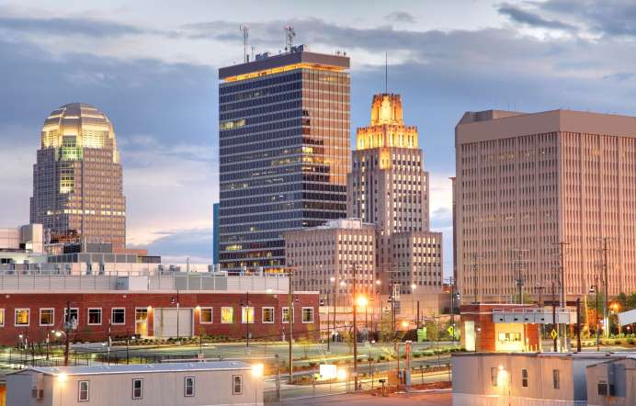
Winston, Salem, North Carolina

Slide 47
We’ll see more soon…

